Slide 1

Predicting Whether a Customer Will Subscribe to a Term Deposit
PREPARED BY
PEYAL BHATTACHARJEE (A21021)

Slide 2
PROBLEM DESCRIPTION
The dataset is related with direct marketing campaigns (phone calls) of a Portuguese banking institution.
Telephonic marketing campaigns still remain one of the most effective way to reach out to people. However, they require huge investment as large call centers are hired to actually execute these campaigns. Hence, it is crucial to identify the customers most likely to convert beforehand so that they can be specifically targeted via call.
The classification goal of this dataset is to predict if the client or the customer of a banking institution will subscribe a term deposit product of the bank or not.
The dataset is taken from the UCI Machine Learning Repository. Link for the same is - https://archive.ics.uci.edu/ml/datasets/Bank+Marketing

Slide 3
INTRODUCTION
Marketing is a process by which companies create value for customers and build strong customer relationships in order to capture value from customers in return.
Marketing campaigns are characterized by focusing on the customer needs and their overall satisfaction.
There are different variables that determine whether a marketing campaign will be successful or not.
There are certain variables that we need to take into consideration when making a marketing campaign.

Slide 4
INTRODUCTION CONTINUED
What is a Term Deposit?
A term deposit is a cash investment held at a financial institution. Your money is invested for an agreed rate of interest over a fixed amount of time, or term. Term deposits can be invested into a bank, building society or credit union.
When the money is deposited, the customer understands that the money is there for the pre-determined period which usually ranges from 1 month to 5 years and the interest rate is guaranteed not to change for that nominated period of time. Typically, the money can only be withdrawn at the end of the period – or earlier with a penalty attached.
Term deposits are popular with investors who prefer capital security and a set return as opposed to the fluctuations of, say, the share market. Many investors also use term deposits as a part of their investment mix. For more information with regards to Term Deposits please click on this link from Investopedia: https://www.investopedia.com/terms/t/termdeposit.asp

Slide 5
DATASET DESCRIPTION
Here is the description of all the variables :
age: Age of the client
job: Type of job
marital: Marital status of the client
education: Education level
default: Credit in default
housing: Housing loan
loan: Personal loan
contact: Type of communication
balance: Balance level
month: Contact month
day: Day of week of contact
duration: Contact duration
campaign: number of contacts performed during this campaign to the client
pdays: number of days that passed by after the client was last contacted
previous: number of contacts performed before this campaign
poutcome: outcome of the previous marketing campaign
Deposit (target): has the client subscribed a term deposit?

Slide 6
APPROACH
Below are some of the basic steps that was taken in the initial phase –
Installed the latest version of Spark
Imported all the required libraries Pipeline, Quantile Discretizer, One Hot Encoder, Logistic Regression, Decision Tree Classifier, Random Forest Classifier etc.
Imported the dataset from Local Machine
Read the colon separated file.
Checked the Data types of each column
Checked the 1st few records of the DataFrame
Verified the count of the dataset after uploading the same

Slide 7
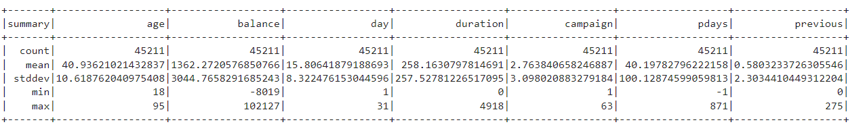
SUMMARY STATISTICS OF THE DATASET
Below are the summary statistics of the columns that has data types as ‘int’ –
Mean age of the customer is 41 years and the standard deviation is 10 years. Distribution is right skewed.
Mean balance is 1362 while the median is 3044. Distribution is left skewed.
Mean of contact duration is 258 seconds while standard deviation is 257 seconds.
Renamed the target column as ‘deposit’ to go with the naming convention.

Slide 8
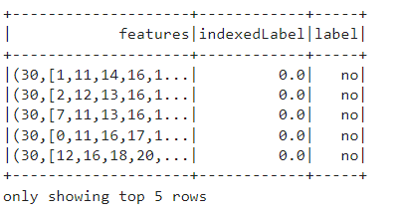
DATA PREPROCESSING
Used the string indexer function that indexes each categorical variable and converts the indexed categories into one-hot encoded variables
The data is then put through all of the feature transformations
Created a user defined function to execute the same
Defined ordered lists of categorical as well as numerical variables after which the data was transformed. Below is the sample snip –

Slide 9
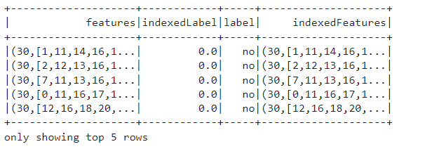
DATA PREPROCESSING CONTINUED
Fitted the feature indexer model on the full bank dataframe
Automatically identified categorical features and indexed them
Set the maxCategories features > 4 so that features satisfying the criteria will be treated as continuous
Below is the data snip –

Slide 10
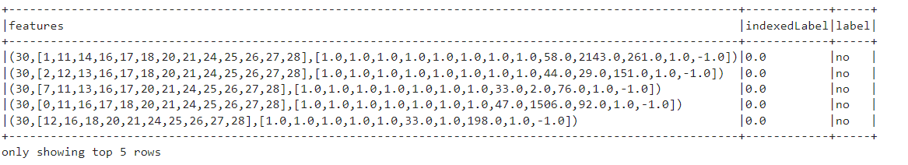
DATA PREPROCESSING CONTINUED
Before splitting the data, lets us check the 1st few features with their indexed label and labels –

Slide 11
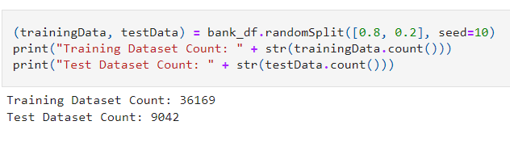
DATA SPLITTING
Split the data randomly in training and testing sets
According to the count, there are 36169 in training dataset and 9042 in the test dataset

Slide 12
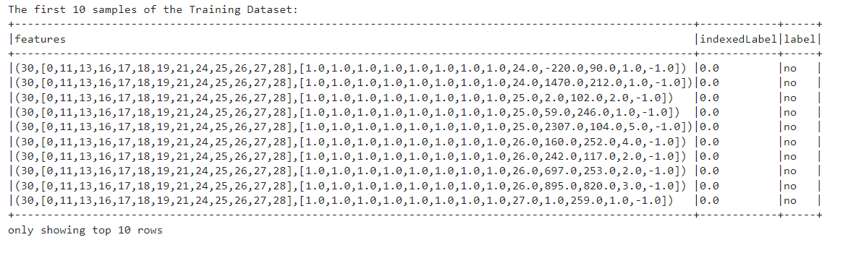
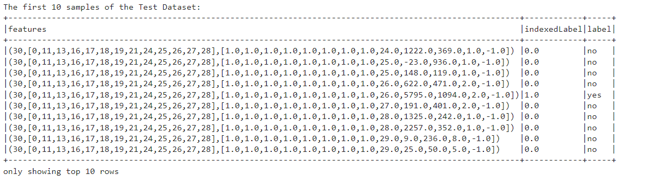
CHECKING THE FIRST FEW SAMPLES OF TRAIN AND TEST
Training set
Test set

Slide 13
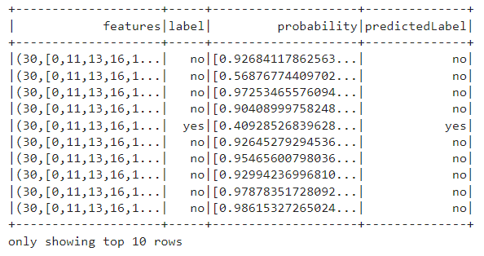
EVALUATING MACHINE LEARNING MODELS – LOGISTIC REGRESSION
Fitted the training data with logistic regression algorithm
Predicted on the test set
Generated the predictions
Checked the models prediction and probabilities of each prediction class

Slide 14
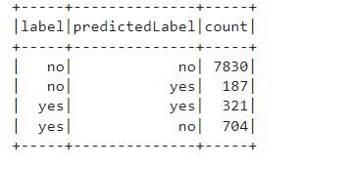
MODEL ACCURACY
In the test dataset there are 1025 customers that have the intension to subscribe a deposit and 8017 who does not
The classifier, however, predicted 508 clients having the intention to subscribe a deposit
Computed the accuracy of the model by computing the count when the labels are correctly classified over the total number of rows
The accuracy of the test set is coming as 0.901

Slide 15
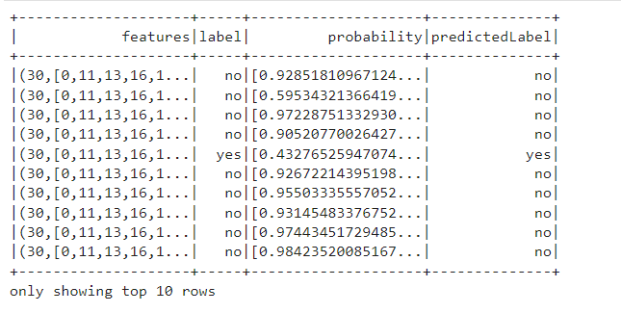
FINE TUNING MODEL
Created and ran 5 fold cross validation
Used the test data to measure the accuracy of the model
Below are the probabilities and their corresponding predictions –

Slide 16
EVALUATING MACHINE LEARNING MODELS – DECISION TREE
Fitted the training data with logistic regression algorithm
Predicted on the test set
Generated the predictions
The accuracy of the test set came at 0.89
Performed hyperparameter tuning with 5-fold cross validation
After comparing it was found out that hyperparameter tuning did not result into significant improvement in model performance

Slide 17
EVALUATING MACHINE LEARNING MODELS – RANDOM FOREST
Fitted the training data with logistic regression algorithm
Predicted on the test set
Generated the predictions
The accuracy of the test set came at 0.888
Performed hyperparameter tuning with 5-fold cross validation
After comparing it was found out that hyperparameter tuning did not result into significant improvement in model performance

Slide 18
EVALUATING MACHINE LEARNING MODELS – ROC, PRECISION, RECALL
Compared the ROC, AUC, Precision and Recall of all the 3 models
Upon comparing we can see that Logistic Regression model performed well as compared to the other two in this case
MODEL NAME | PRECISION | RECALL | AREA UNDER PRECISION-RECALL | AREA UNDER ROC
LOGISTIC REGRESSION | 0.63 | 0.31 | 0.45 | 0.64
DECISION TREE | 0.55 | 0.34 | 0.4 | 0.65
RANDOM FOREST | 0.74 | 0.01 | 0.43 | 0.51

Slide 19
RESULTS ACHIEVED
We can see that all of our models performed pretty well on our dataset
Hyperparameter tuning was not so effective in improving the accuracy of the model for all the 3 algorithms
We have been able to predict that whether a customer is going to subscribe to a term deposit or not. The results will help us to target potential customers which means upon seeing the customer profile we can very well say whether the given customer will be subscribing to a term deposit or not.
Among all the 3 algorithms that we used, Logistic Regression model performed the best among all of them

Slide 20
GENERAL DISCUSSION AND CONCLUSION
Marketing to potential clients has always been a crucial challenge in attaining success for banking institutions
Banks usually deploy mediums such as social media, customer service, digital media and strategic partnerships to reach out to customers
Banks need to market to a specific location, demographic, and society with increased accuracy
With the help of Machine Learning, one can provide detailed strategies to inform banks which customers are more likely to subscribe to a financial product
Hence, one can save time and money knowing the characteristics of customers one should target to and that will lead to increased growth and revenue

